Slide 1
Data Science & Apache Spark Overview Data tools for Data Professionals
Notes:
Any data professionals?
Quick round table of who you are and what you do ….
Great! How many of you have heard of spark? Used spark?

Slide 2
Agenda
IBM Data Science Overview
Apache Spark Overview
Hands-on Labs
Lab 0 – DSX Fundamentals
Lab 1 – Machine Learning with Model Builder
Lab 2 – Machine Learning with Flow Editor
Lab 3 – Machine Learning with Python Notebook
Lab 4 – Introduction to SparkSQL
Networking
Notes:
Hands on labs will be in spark, and we will put into practice what we have gone over…
We have 3 labs and I normally give the room about 45 min- hour to do each lab....

Slide 3
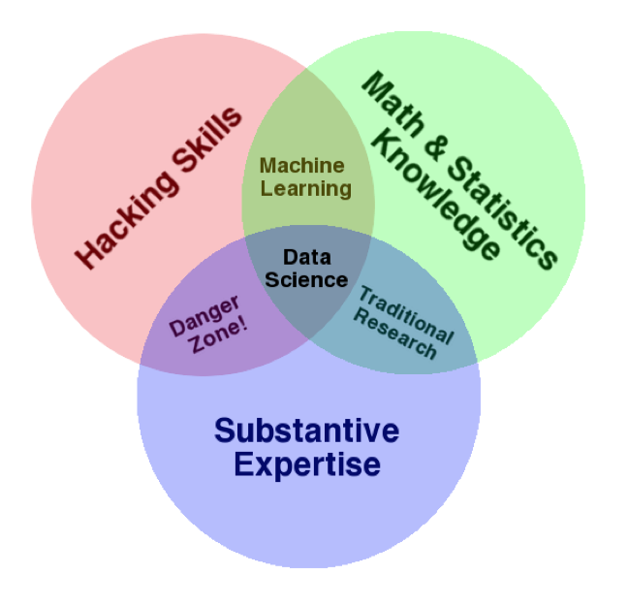
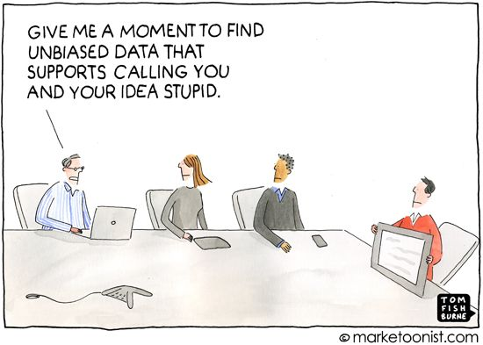
Data Science
What is it?
Why do we need it?
We need Data Science to make valid, objective inferences from data, free from human bias – KDNuggets
Notes:
It Is an interdisciplinary field
It sits at the intersection of quite a few skill sets
While Machine learning & Data Science are closely related, data science differentiates itself by also requiring domain knowledge.
For example, you may have some background in genomics and when presented with such a set, you apply what you know to convert your data into something which machine learning models can use, we will see a small example of this later on during our labs
**Or, in other words - - when given a problem to solve, such as improve user experience at a theme park - - you know the pieces of data that you’ll need to do predictive analytics
And while it is indeed a wide set of skills to be mastered, good news for us is that a lot of tools out there abstract away all the nitty gritties of these skills
**Data Science Experience is a great tool that simplifies many data science processes, depending on the user
All you need to know is the uses of each and how and where to apply them. We will see a some examples later on in our hands on lab
________
We need data science to be able to answer business questions (i.e. – why are customers churning? / what drives box office dollars in a given city/for a given movie.. Etc.)
You want to be able to know if the KPIs you have defined for your business are looking good/up to expectations, and if they are a result of your marketing efforts or some external factors.
More concisely, you want to be able to make decisions based on something solid and not just because your gut says so.
KDNuggets: leading site on BA, Big Data, Data Mining, Data Science and Machine Learning (Gregory Piatetski – Shapiro / Matthew Mayo)

Slide 4

Data Scientist Persona: Current Challenges
Rigid toolset
Have to choose one and only one approach
Cannot easily connect all capabilities required
Difficult to navigate between various tools used
Fragmented and time consuming
Using multiple, disjoint environments
Separate, on-ramp/community for each tool/individual
Does not have metadata or data lineage
Analytical silo
Difficult to maintain and version control project assets
Limited means of collaborating with teams
Results are difficult to share
Notes:
We tried to highlight points which elongated “Time to Live “ in projects within business ….
Rigid toolset
Especially with different personas/different types of users
Fragmented & time consuming….

Slide 5




Watson Data Platform an integrated platform of tools, services and data that helps companies accelerate their shift to become data-driven organizations
Drive governance policy effectiveness while tracking how data is used and its value to the company
Data Steward
Access powerful tools to prepare data to tease out the insights they’re looking for, without IT involvement
Data Scientist
Data Engineer
Easily build data pipelines that power dashboards and data platforms while ensuring high quality
App Developer
Make the insights immediately actionable and add intelligence to apps in straightforward manner
Notes:
Watson data platform is THE IBM public cloud foundation designed to support the data and analytics vision of whole enterprises
Delivering a fully integrated platform that sustains both analytical investigations and putting insights into active use in production at any scale.
It delivers the user experiences that amplify the ability of every data professional to execute on that vision

Slide 6
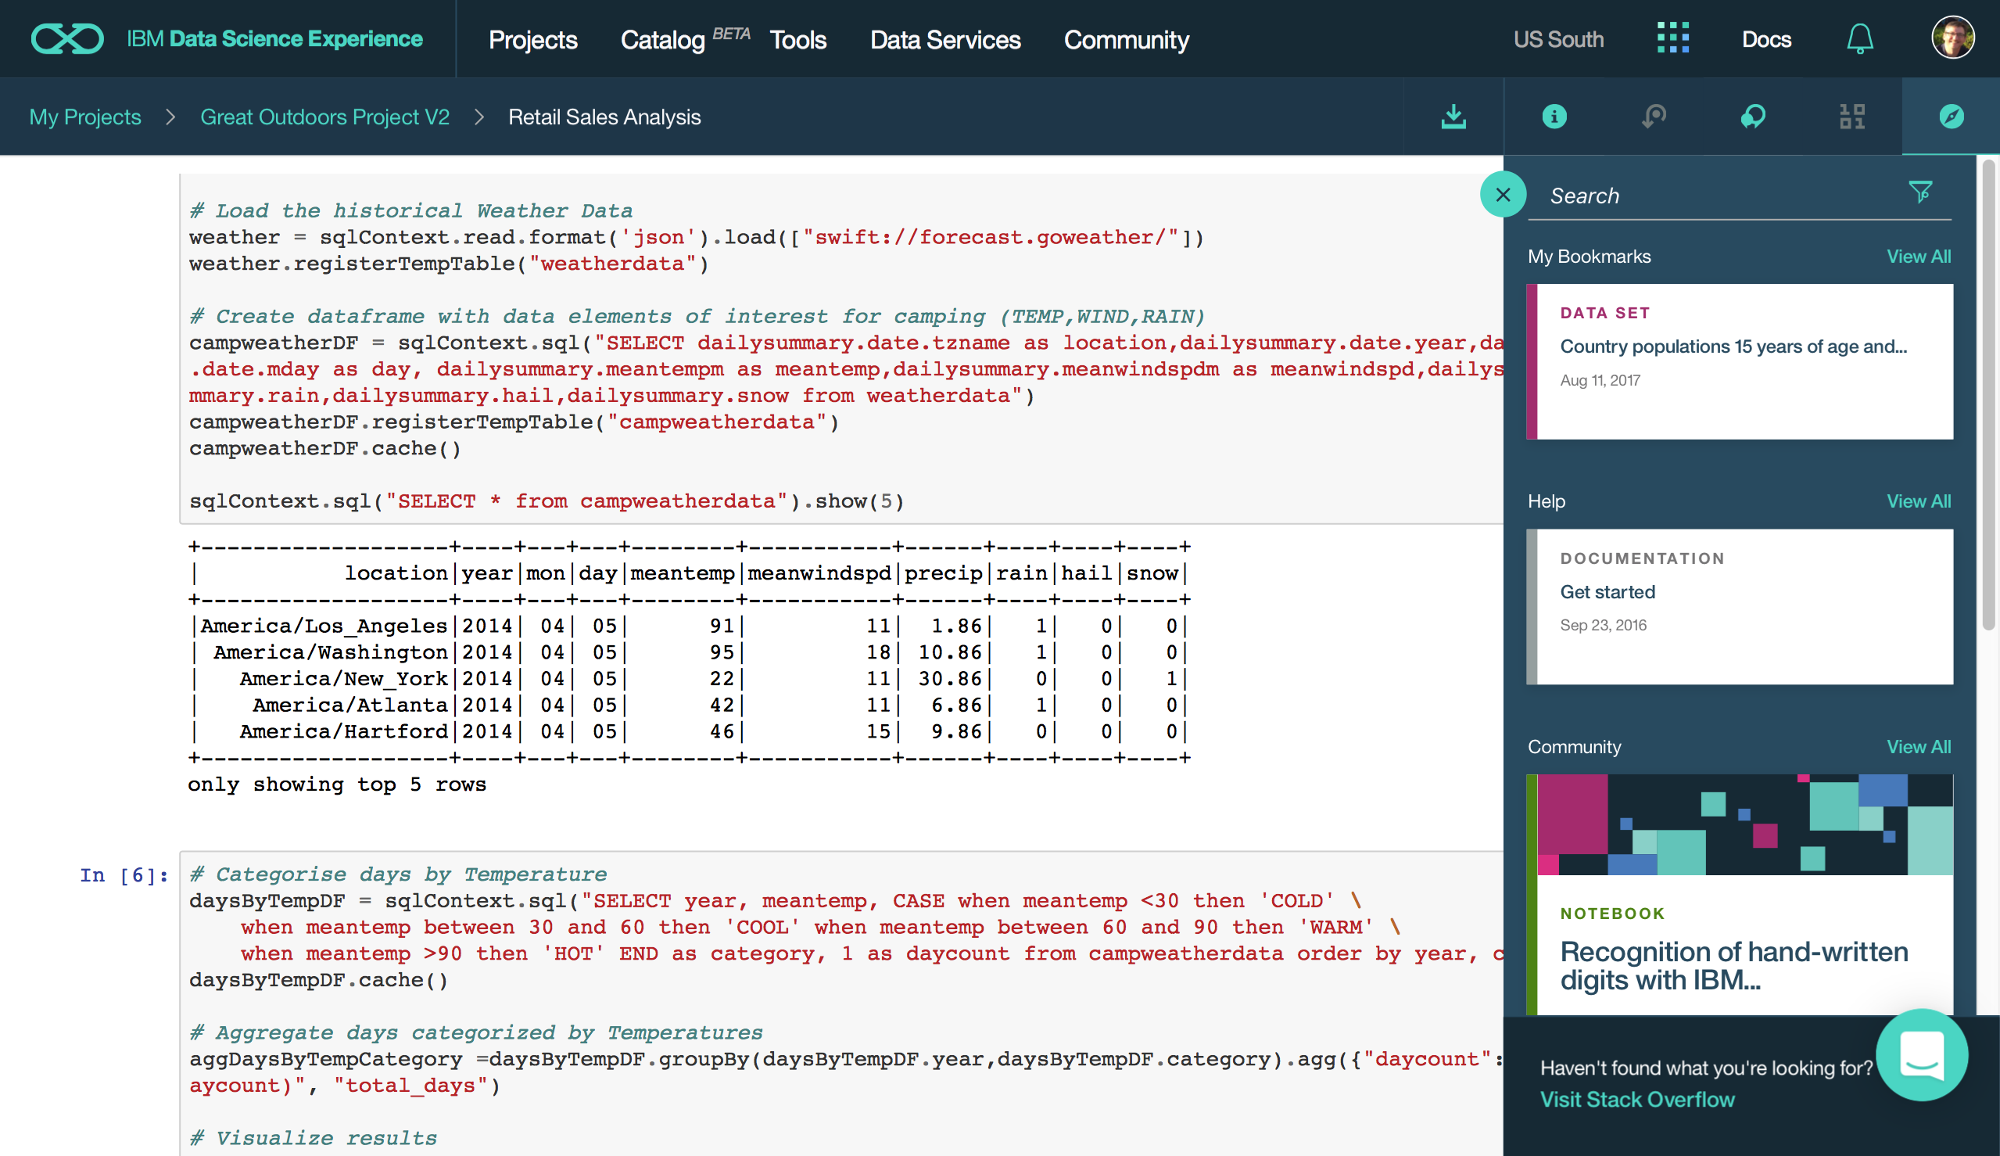
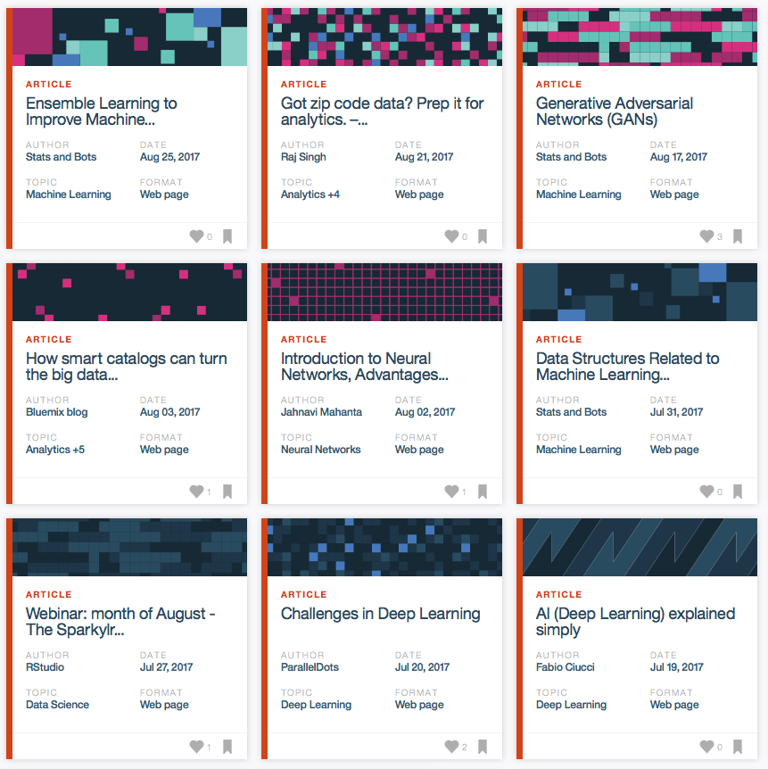
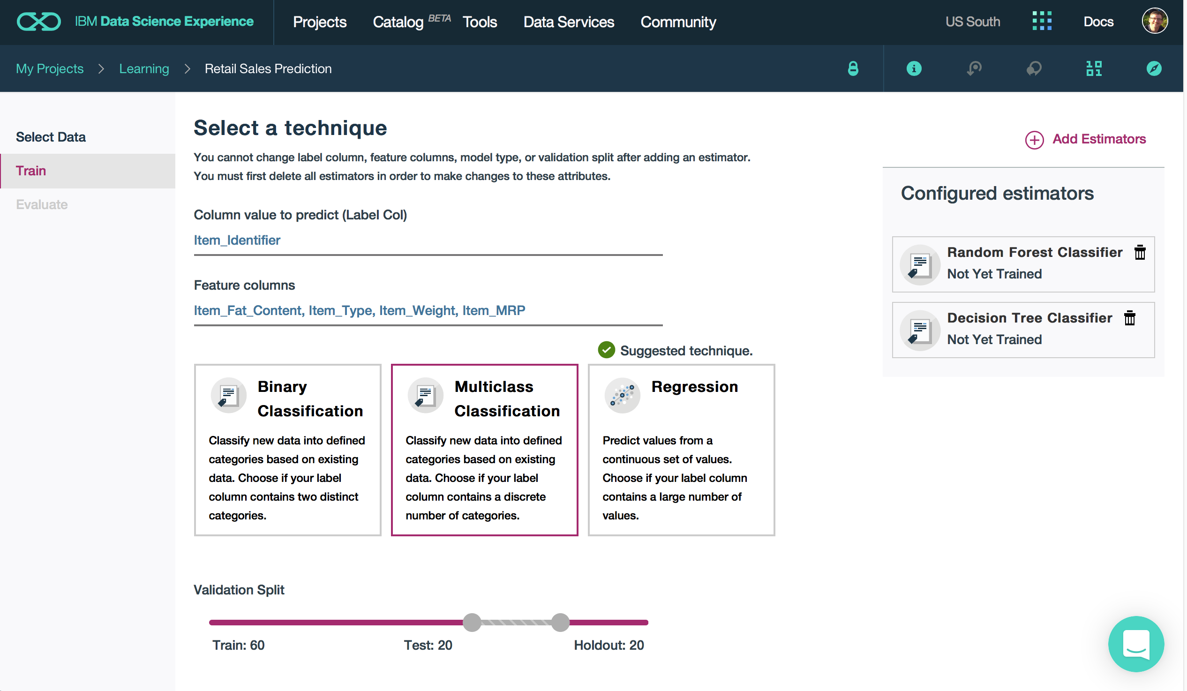
Watson Data Platform
Data Science Experience
Making data science a team sport
Learn
Built-in learning to get started or go the distance with advanced tutorials
Create
The best of open source and IBM value-add to create state-of-the-art data products
Collaborate
Community and social features that provide meaningful collaboration
Notes:
WDP delivers rich persona driven experiences that solve specific business problems:
Data Science
Data Discovery & Cataloging
Data Integration & Movement
Now let’s dig into the IBM Data Science Experience (DSX). DSX is a single place to Learn, Create, and Collaborate – the 3 pillars of a successful data science organization.
With DSX we are making it easier for data scientists and data science teams to learn new skills and technologies in the fast moving data science profession.
DSX provides freely available datasets, code samples, tutorials and articles from the data science community, making it easier for data scientists to learn in-context.
We also know that a data science team isn’t going to standardize on a single technology or tool – data scientists need an open and integrated platform that brings all of their tools in one place. DSX brings together the best of open source such as RStudio, Spark, and Python in an integrated environment along with IBM value-adds, such as a managed Spark service and data shaping capabilities all in a secure and governed way.
Users can collaborate in DSX with ease -- you can manage project assets and user collaboration through built-in social features for sharing, forking, and reusing assets. These built-in collaboration features can really help boost team productivity and managing projects across their lifecycle.
FYI:
DSX is a single platform to Learn, Create, and Collaborate – the 3 pillars of a successful data science organization.
Learn: Learn from each other & develop new skills
Benefit from the community aspect, read recently published articles, leverage tutorials and existing notebooks to do things you’ve never done before
Create: Create projects in the environment of your choice
Seamlessly….with all tools and data at your fingertips
Collaborate: Within your organization, with your colleagues and outside - with other data professionals (you even chat with data scientists from IBM).

Slide 7
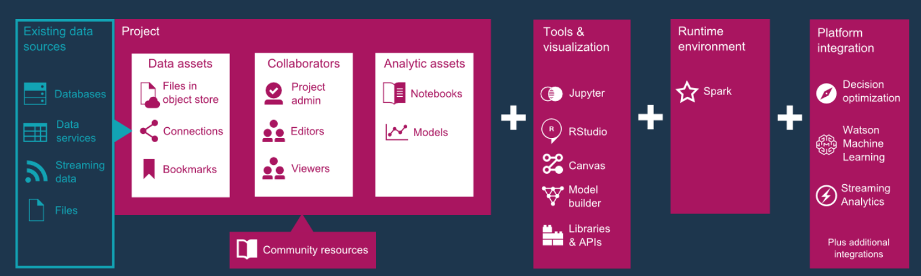
Projects allow users to work and collaborate

Slide 8
DSX - Machine Learning in Projects, deploying to WML
Create & Train
Deploy
Invoke
ML in DSX Projects
ML Flows ML Wizard
ML Notebooks
ML Models
Watson Machine Learning Service
REST
API to
call
Model
Apps on Bluemix or others
ML Flows
Data Scientists can train ML models in DSX using data in Projects to create and train models
Use ML Wizard for assisted creation and training of models using common patterns and algorithms
Use Notebooks or Flows to train models for more advanced use cases and more flexibility
Deploy models to Watson Machine Learning (WML) service in Bluemix to run them in production
Use WML REST API to invoke your models for online scoring / predictions

Slide 9
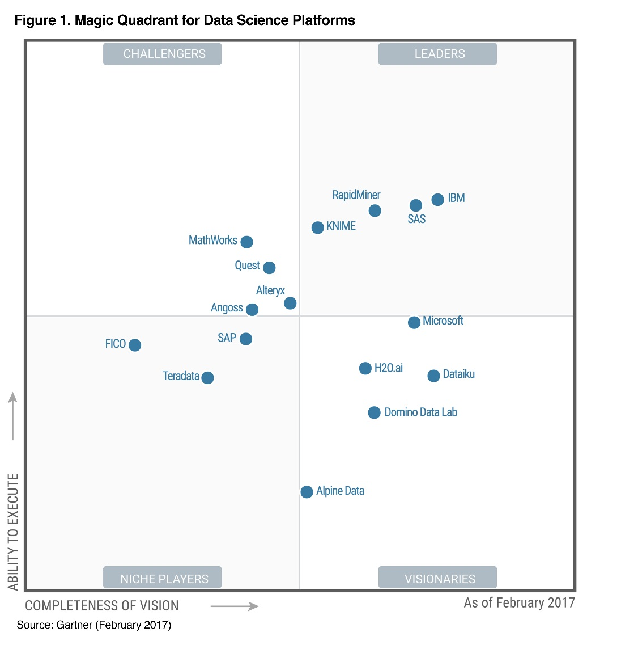
2017 Gartner Magic Quadrant for Data Science Platforms
IBM is positioned as a Leader in the 2017 Gartner Magic Quadrant for Data Science Platforms, based on its ability to execute and completeness of vision.
IBM is positioned highest in execution and furthest in vision within the Leaders Quadrant.
This is the fourth consecutive year for IBM to be recognized as a leader in this report.
Source: Gartner Magic Quadrant for Data Science Platforms, Alexander Linden, Peter Krensky, Jim Hare, Carlie J. Idoine, Svetlana Sicular, Shubhangi Vashisth, 14 February 2017.
This graphic was published by Gartner, Inc. as part of a larger research document and should be evaluated in the context of the entire document. The Gartner document is available upon request from IBM. Gartner does not endorse any vendor, product or service depicted in its research publications, and does not advise technology users to select only those vendors with the highest ratings or other designation. Gartner research publications consist of the opinions of Gartner's research organization and should not be construed as statements of fact. Gartner disclaims all warranties, expressed or implied, with respect to this research, including any warranties of merchantability or fitness for a particular purpose.

Slide 10

Spark is an open source
in-memory application framework for
distributed data processing and
iterative analysis
on massive data volumes
" Analytic Operating System"
Notes:
Spark is an open source project which came out of UC Berkeley’s AMPLAB, now called the “RiseLab”
It is an in memory, distributed processing, engine
It is designed for heavy workloads
At IBM, we like to call it the “Analytic operating system”
We actually funded the initial Amplab project and continue to fund Riselab

Slide 11
IBM is all-in on Spark
"It's like Spark just got blessed by the enterprise rabbi."
Contribute to the Core
Launch Spark Technology Cluster (STC), 300 engineers
Open source SystemML
Partner with databricks
Ben Horowitz,
Andreessen Horowitz
Foster Community
Infuse the Portfolio
Educate 1M+ data scientists and engineers via online courses
Sponsor AMPLab, creators and evangelists of Spark
Integrate Spark throughout portfolio
3,500 employees working on Spark-related topics
Spark however customers want it – standalone, platform or products
Notes:
We are all in on spark
We have a center in San Francisco where our engineers are dedicated to contributing to spark, they do not work on any other project
We aim to hire about 300 engineers, we are as many 70 as of now
We have also developed and open sourced SystemML which is a machine learning library
We also offer sponser AMPLab where spark was born and we are continuing to invest in RiseLab
There is also free education on big data university for spark and other big data courses
And lastly, spark is a component in a lot of our products and the number is rising, we also offer it on a standalone basis
The quote in the upper right corner is important. It shows the impact IBM has when it supports a product.
It gives legitimacy to Spark for the enterprise. Now enterprise customers can use Spark and know that IBM is behind it. It is appropriate for enterprise software.
Still, IBM wants to make sure it is successful by using this three pronged approach.
One of the main goal being to become the number one contributor to Spark.

Slide 12
Key Reasons for Interest in Spark
Performant
Productive
Leverages existing investments
Improves with age
Notes:
Performant:
Fast (20-100x faster when compared to Hadoop MapReduce)
Productive:
- Lesser code lines
One of the reasons for increased productivity is the fact that Spark comes with a set of classes and methods that allow a programmer to get to the desired result faster. MapReduce did not have those pre-built capabilities.
NOTE: having pre-built capabilities does not necessarily remove the learning curve to become competent with the product.
Leverage Existing Investments:
You can still use your Hadoop environment
No wastage….
Improves with Age:
Extremely popular
Code evolves quickly
Becomes easier to use by the day...
* Spark is the largest and most active Apache project. As we’ll see later, the product has evolved quickly and will
certainly continue to do so for quite a while.

Slide 13










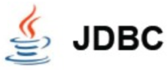



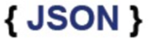





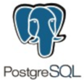






From a Notebook…
Execute SQL Statements
Streaming Analytics via Micro-batch
M.L. and Statistical Algorithms
Distributed Graph Processing Framework
Spark SQL
Spark Streaming
MLlib Machine Learning
Graph
General compute engine
Basic I/O functions
Task dispatching
Scheduling
Spark Core
Data Sources
IBM Cloud | Public Cloud | Cloud Apps | On-Premises
BigInsights (HDFS)
Cloudant (DBaaS)
dashDB (Analytics)
SQDB (Managed DB2)
Swift (Object Storage)
You can use IBM’s managed Spark Service to blend multiple data types, sources and workloads
Notes:
From a Notebook in DSX you can use IBM Analytics for Apache Spark to blend multiple data types, sources, and workloads. IBM Analytics for Apache Spark is a fully managed service on Bluemix.
For example, Spark SQL is available to address the needs of so many of our current customers and partners that want to be able to work with their traditional relational databases, using a performant and powerful technology like Spark, but be able to do so without needing to know how to code MapReduce jobs in Java. Using SparkSQL, a developer can apply their knowledge of SQL statements directly in Spark code, and tap into a large number of relational databases Spark supports in order to apply in-memory analytics over bread and butter relational SQL databases.
And beyond SparkSQL, we can attack new problems with Spark’s machine learning library, Spark Streaming, and Graph. The power of Spark is the ease of developing analytics applications using a unified framework across all of these libraries. For more details on this please check the appendix of this deck.
Towards the bottom of the slide, I've highlighted the connection opportunities we have with Spark today – and keep in mind that this list is not exhaustive and is ever-expanding. Focus your attention particularly on the integrations with the IBM portfolio (on the left) that we support currently. Of course, the logical fits are there: connect Spark to BigInsights On-Premises or BigInsights on Cloud to land your data in HDFS and access the suite of enterprise-grade technologies we support atop BigInsights. But consider as well the dramatic innovations in areas like our button-push connectivity to databases like NoSQL database-as-a-service Cloudant. Application developers, Web services, and mobile apps now have direct-line access to an in-memory analytic processing framework that can even handle near-real time ingest of data from Internet of Things data streams and messaging hubs.
The best practice for the Spark service is using object storage (Swift) as the data store.

Slide 14
Hands-on Labs
https://github.com/lindsaywithers/dsx-spark
Notes:
Git Repo: https://github.com/lindsaywithers/dsx-spark

Slide 15
Lab 1 Summary
The model builder is ideal for the data professionals in your organization who are looking to leverage machine learning without having to write a single line of code. In this section, the model builder in DSX guided us through the steps required to build, train and deploy a model that can be embedded into an application - with only a few clicks.

Slide 16
Lab 2 Summary
Professionals across the organization have different preferences for how to work with data. For some, the ability to visualize the flow of data from left to right is important. For these personas, Data Science Experience provides the Flow Editor. In this section, we explored machine learning with our data in a more visual way. One of the hardest things in Machine Learning is to understand how a trained model will perform in production. With this model visualization component, you can immediately see which features have the most impact on your predictions with variable importance.

Slide 17
Lab 3 Summary
In labs 1 and 2, we saw how DSX enables predictive model building and deployment without requiring any code. In this section – we utilized the power of Jupyter notebooks by loading in data from an external source, doing some basic data cleansing and exploration, building a pipeline, training a model and then persisting that model in a WML repository. With these three approaches to machine learning, we empower the data professional to use the tools of their choice to accomplish day-day tasks.

Slide 18
Lab 3 Summary
In labs 1 and 2, we saw how DSX enables predictive model building and deployment without requiring any code. In this section – we utilized the power of Jupyter notebooks by loading in data from an external source, doing some basic data cleansing and exploration, building a pipeline, training a model and then persisting that model in a WML repository. With these three approaches to machine learning, we empower the data professional to use the tools of their choice to accomplish day-day tasks.

Slide 19
Lab 4 Summary
In this section we leveraged the Spark compute engine, and SparkSQL library to query our structured data from within a python notebook. The ability to combine SQL queries with the speed of Spark significantly reduces the time to value in any data science initiative – getting you to your insights faster.

Slide 20
Spark Internals
Notes:
Spark is a distributed processing framework.

Slide 21










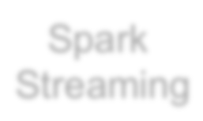
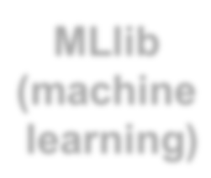

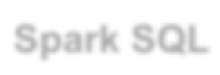







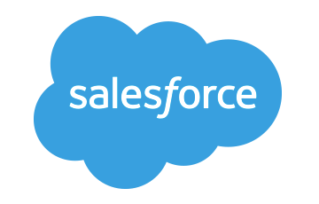





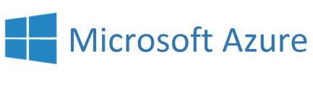






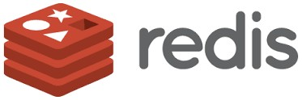
Spark Ecosystem
executes SQL statements
performs streaming analytics using micro-batches
common machine learning and
statistical algorithms
distributed graph processing framework
Execute R
Statistical code against Spark Code
Spark SQL
Spark Streaming
MLlib (machine learning)
GraphX (graph)
SparkR
general compute engine, handles
distributed task dispatching,
scheduling and basic I/O functions
Spark Core Engine
large variety of data sources and formats can be
supported, both on premise or cloud
BigInsights (HDFS)
Cloudant
dashDB
SQL DB
Object Storage
…many others
IBM CLOUD
OTHER CLOUD
CLOUD APPS
ON-PREMISE
Notes:
Spark includes a set of core libraries that enable various analytic methods which can process data from many sources (Spark is completely agnostic to data sources)
Along the bottom are the large variety of data sources and formats that can be supported, both on premise or cloud
In the middle, is the general compute engine, which handles distributed tasks, dispatching and basic I/O functions
At the top – are the Spark libraries

Slide 22










Libraries Usage
SparkSQL − 69%
Spark SQL
Spark Streaming
MLlib
Machine Learning
GraphX
Graphing
DataFrames − 62%
Spark Streaming − 58%
MLlib/GraphX − 58%
Spark Core
75% of users use more than one component
Notes:
Note that DataFrames are datasets that make the data look like relational tables.
From this chart, we can conclude that SQL access to data is the most popular interface used. Some would say it is ironic considering all the NoSQL hoopla of the last several years. This points to the fact that people want more productivity through the use of simpler interfaces. The SQL approach has that advantage and also potentially removes many performance burdens from a programmer.
*** We will get hands on with SparkSQL in Lab 2 today
*** We will also get hands on with MLlib in Lab 3

Slide 23
Spark Programming Languages
Language | 2014 | 2015 | 2016
Scala | 84% | 71% | 65%
Java | 38% | 31% | 29%
Python | 38% | 58% | 62%
R | unknown | 18% | 20%
Notes:
Reference: Survey by Databricks
This chart shows that usage of programming languages is changing… This is not to say that scala is becoming less popular, it is likely because the type of people adopting Spark are coming more and more from a data science background which favors the use of Python and R.
**More data scientists are using Spark**

Slide 24
IBM is all-in on Spark
"It's like Spark just got blessed by the enterprise rabbi."
Contribute to the Core
Launch Spark Technology Cluster (STC), 300 engineers
Open source SystemML
Partner with databricks
Ben Horowitz,
Andreessen Horowitz
Foster Community
Infuse the Portfolio
Educate 1M+ data scientists and engineers via online courses
Sponsor AMPLab, creators and evangelists of Spark
Integrate Spark throughout portfolio
3,500 employees working on Spark-related topics
Spark however customers want it – standalone, platform or products
Notes:
We are all in on spark
We have a center in San Francisco where our engineers are dedicated to contributing to spark, they do not work on any other project
We aim to hire about 300 engineers, we are as many 70 as of now
We have also developed and open sourced SystemML which is a machine learning library
We also offer sponser AMPLab where spark was born and we are continuing to invest in RiseLab
There is also free education on big data university for spark and other big data courses
And lastly, spark is a component in a lot of our products and the number is rising, we also offer it on a standalone basis
The quote in the upper right corner is important. It shows the impact IBM has when it supports a product.
It gives legitimacy to Spark for the enterprise. Now enterprise customers can use Spark and know that IBM is behind it. It is appropriate for enterprise software.
Still, IBM wants to make sure it is successful by using this three pronged approach.
One of the main goal being to become the number one contributor to Spark.

Slide 25
Spark Terminology
Context (Connection):
Represents a connection to the Spark cluster. The Application which initiated the context can submit one or several jobs, sequentially or in parallel, batch or interactively.
Driver (Coordinator agent)
The program or process running the Spark context. Responsible for running jobs over the cluster and converting the App into a set of tasks
Job (Query / Query plan):
A piece of logic (code) which will take some input from HDFS (or the local filesystem), perform some computations (transformations and actions) and write some output back.
Stage (Subplan)
Jobs are divided into stages
Tasks (Sub section)
Each stage is made up of tasks. One task is executed on one partition (of data) by one executor
Executor (Sub agent)
The process responsible for executing a task on a worker node
Notes:
Context – Handle to your cluster, each application will have its own context. At a given point of time, there can be several contexts on a cluster
Driver – Works hand in hand with the context, it is a program which runs on the master node and is responsible for generating an execution plan (DSX?)
Job – a single piece of code which you will submit to the cluster (and this job will be divided by the driver into smaller pieces to be run on worker nodes) - - (this will be done in labs 1 and 2)
Stage – a part of the job (you will observe as the job is run in stages within DSX)
Tasks - the most atomic piece of code, this runs on the worker nodes, each worker node will have a single task for the given job.

Slide 26
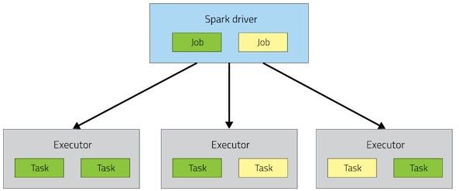
Spark Architecture
Application

Slide 27
A Spark application is initiated from a driver program
Each Spark application runs as a set of processes coordinated by the Spark context object (driver program)
– Spark context connects to Cluster Manager (standalone, Mesos/Yarn)
Spark context acquires executors (JVM instance) on worker nodes
Spark context sends tasks to the executors
Worker Node
Executor
Cache
Task
Task
Driver Program
Cluster Manager
App
SparkContext
Worker Node
Executor
Cache
Task
Task
Notes:
Driver Program – Python?
Spark Context – connection to the cluster/Spark service (running in the background)

Slide 28
Resilient Distributed Datasets
RDD is a distributed collection of Scala/Python/Java objects of the same type:
Strings
Integers
(key, value) pairs
class Java/Python/Scala objects
RDDs are immutable
Modifications create new RDDs
Physically distributed across cluster, but manipulated as one logical entity:
Spark will “distribute” any required processing to all partitions where the RDD exists and perform necessary redistributions and aggregations as well.
Example: Consider a distributed RDD “Names” made of names
Partition 1
Partition 2
Partition 3
Names
Mokhtar Jacques Dirk
Cindy Dan Susan
Dirk Frank Jacques
Notes:
Primary data type in Spark - Spark is based on the concept of a Resilient Distributed Dataset (RDD).
*The key to parallel processing in Spark is the partitioning of an RDD.
For example, if an RDD comes from an HDFS file, it will be partitioned based on the number of blocks available. There are transformations in Spark that allows to repartition an RDD to improve the overall performance by either increasing or even decreasing the number of partition. In general RDD partitions are kept in-memory, but parameters can be set to allow for spilling to disk if needed.
An RDD cannot be modified. Any transformation on an RDD will result is a new RDD. An RDD resilience lies in the fact that it keeps track of where it came from. If an RDD is lost for any reason, it can be reconstructed from one of its ancestors. This chain of modifications is referred to as lineage.
In the execution of a Spark application, multiple RDDs are created since RDDs are immutable. This means that the memory requirements can be much greater than the size of the input file. For this reason, RDDs can be removed during the processing. If they happen to be needed later, they can be recreated from their lineage. To help performance, it is possible to “persist” an RDD so it would not have to be re-created.
It is a basic unit of computation…. Just as a database holds tables...and those tables can then contain data of different types, an RDD is a unit which contains data in the spark world.

Slide 29
Resilient Distributed Datasets
Suppose we want to know the number of names in the RDD “Names”
User simply requests: Names.count()
Spark will “distribute” count processing to all partitions so as to obtain:
Partition 1: Mokhtar(1), Jacques (1), Dirk (1) è 3
Partition 2: Cindy (1), Dan (1), Susan (1) è 3
Partition 3: Dirk (1), Frank (1), Jacques (1) è 3
Local counts are subsequently aggregated: 3+3+3=9
To lookup the first element in the RDD: Names.first()
To display all elements of the RDD: Names.collect() (careful with this)
Names Partition 2
Partition 1
Partition 3
Mokhtar Jacques Dirk
Cindy Dan Susan
Dirk Frank Jacques
Notes:
The collect () method will print all elements on the driver, and can cause the driver to run out of memory - - because collect() fetches the entire RDD to a single machine; if you only need to print a few elements of the RDD, a safer approach is to use the take(). For example names.take (2)

Slide 30
RDDs
Two types of operations
Transformations
Actions
Fault tolerance
If data in memory is lost it will be recreated from lineage
Notes:
Transformations – creates a new dataset from an existing one
Ex: Map is a transformation that takes each element in an RDD and passes it through a function - and returns new RDD containing results
Actions – return a value to the driver program after running a computation on a dataset
Ex: Reduce is an action that aggregates all of the elements of an RDD using some function, and returns the final result to the driver program
All transformations in Spark are lazy, in that they do not compute their results right away. Instead, they just remember the transformations applied to some base dataset (e.g. a file). The transformations are only computed when an action requires a result to be returned to the driver program. This design enables Spark to run more efficiently. For example, we can realize that a dataset created through map will be used in a reduce and return only the result of the reduce to the driver, rather than the larger mapped dataset.
By default, each transformed RDD may be recomputed each time you run an action on it. However, you may also persist an RDD in memory using the persist (or cache) method, in which case Spark will keep the elements around on the cluster for much faster access the next time you query it. There is also support for persisting RDDs on disk, or replicated across multiple nodes.
Fault Tolerance - - if any partition of an RDD is lost, it will automatically be recomputed using the transformations that originally created it

Slide 31
Code Execution (1)
// Create RDD
val quotes = sc.textFile("hdfs:/sparkdata/sparkQuotes.txt")
// Transformations
val danQuotes = quotes.filter(_.startsWith("DAN"))
val danSpark = danQuotes.map(_.split(" ")).map(x => x(1))
// Action
danSpark.filter(_.contains("Spark")).count()
// Create RDD
val quotes = sc.textFile("hdfs:/sparkdata/sparkQuotes.txt")
// Transformations
val danQuotes = quotes.filter(_.startsWith("DAN"))
val danSpark = danQuotes.map(_.split(" ")).map(x => x(1))
// Action danSpark.filter(_.contains("Spark")).count()
File: sparkQuotes.txt
DAN Spark is cool BOB Spark is fun
BRIAN Spark is great DAN Scala is awesome BOB Scala is flexible

Slide 32
Code Execution (2)
// Create RDD
val quotes = sc.textFile("hdfs:/sparkdata/sparkQuotes.txt")
// Transformations
val danQuotes = quotes.filter(_.startsWith("DAN"))
val danSpark = danQuotes.map(_.split(" ")).map(x => x(1))
// Action
danSpark.filter(_.contains("Spark")).count()
File: sparkQuotes.txt
RDD: quotes
DAN Spark is cool BOB Spark is fun
BRIAN Spark is great DAN Scala is awesome BOB Scala is flexible

Slide 33
Code Execution (3)
// Create RDD
val quotes = sc.textFile("hdfs:/sparkdata/sparkQuotes.txt")
// Transformations
val danQuotes = quotes.filter(_.startsWith("DAN"))
val danSpark = danQuotes.map(_.split(" ")).map(x => x(1))
// Action
danSpark.filter(_.contains("Spark")).count()
File: sparkQuotes.txt
RDD: quotes
RDD: danQuotes
DAN Spark is cool BOB Spark is fun
BRIAN Spark is great DAN Scala is awesome BOB Scala is flexible

Slide 34
Code Execution (5)
// Create RDD
val quotes = sc.textFile("hdfs:/sparkdata/sparkQuotes.txt")
// Transformations
val danQuotes = quotes.filter(_.startsWith("DAN"))
val danSpark = danQuotes.map(_.split(" ")).map(x => x(1))
// Action
danSpark.filter(_.contains("Spark")).count()
File: sparkQuotes.txt
RDD: quotes
RDD: danQuotes
RDD: danSpark
DAN Spark is cool BOB Spark is fun
BRIAN Spark is great DAN Scala is awesome BOB Scala is flexible

Slide 35
Code Execution (5)
// Create RDD
val quotes = sc.textFile("hdfs:/sparkdata/sparkQuotes.txt")
// Transformations
val danQuotes = quotes.filter(_.startsWith("DAN"))
val danSpark = danQuotes.map(_.split(" ")).map(x => x(1))
// Action
danSpark.filter(_.contains("Spark")).count()
File: sparkQuotes.txt
RDD: quotes
RDD: danQuotes
RDD: danSpark
DAN Spark is cool BOB Spark is fun
BRIAN Spark is great DAN Scala is awesome BOB Scala is flexible
DAN Spark is cool BOB Spark is fun
BRIAN Spark is great DAN Scala is awesome BOB Scala is flexible
DAN Spark is cool DAN Scala is awesome
Spark Scala
1
Notes:
Started with our ’quotes’ RDD, and each transformation (filter, map) created an additional RDD
Lastly, action to give us a count of “Spark” from the danSpark RDD (1)

Slide 36
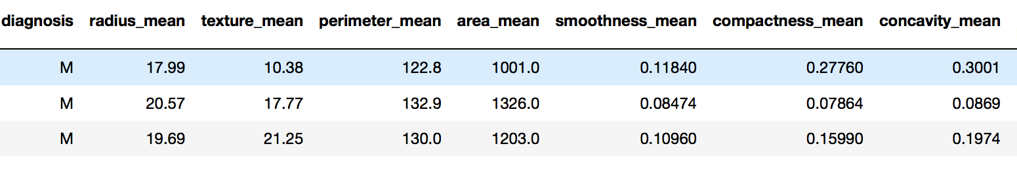
DataFrames
Similar to Pandas DataFrames
Same principles as an RDD
All spark libraries can now handle DataFrames
Notes:
SparkSQL, DataFrames and Datasets –
A rich set of functionality that allows “database-like” processing
*Make the data look like relational tables (SQL like interface)

Slide 37
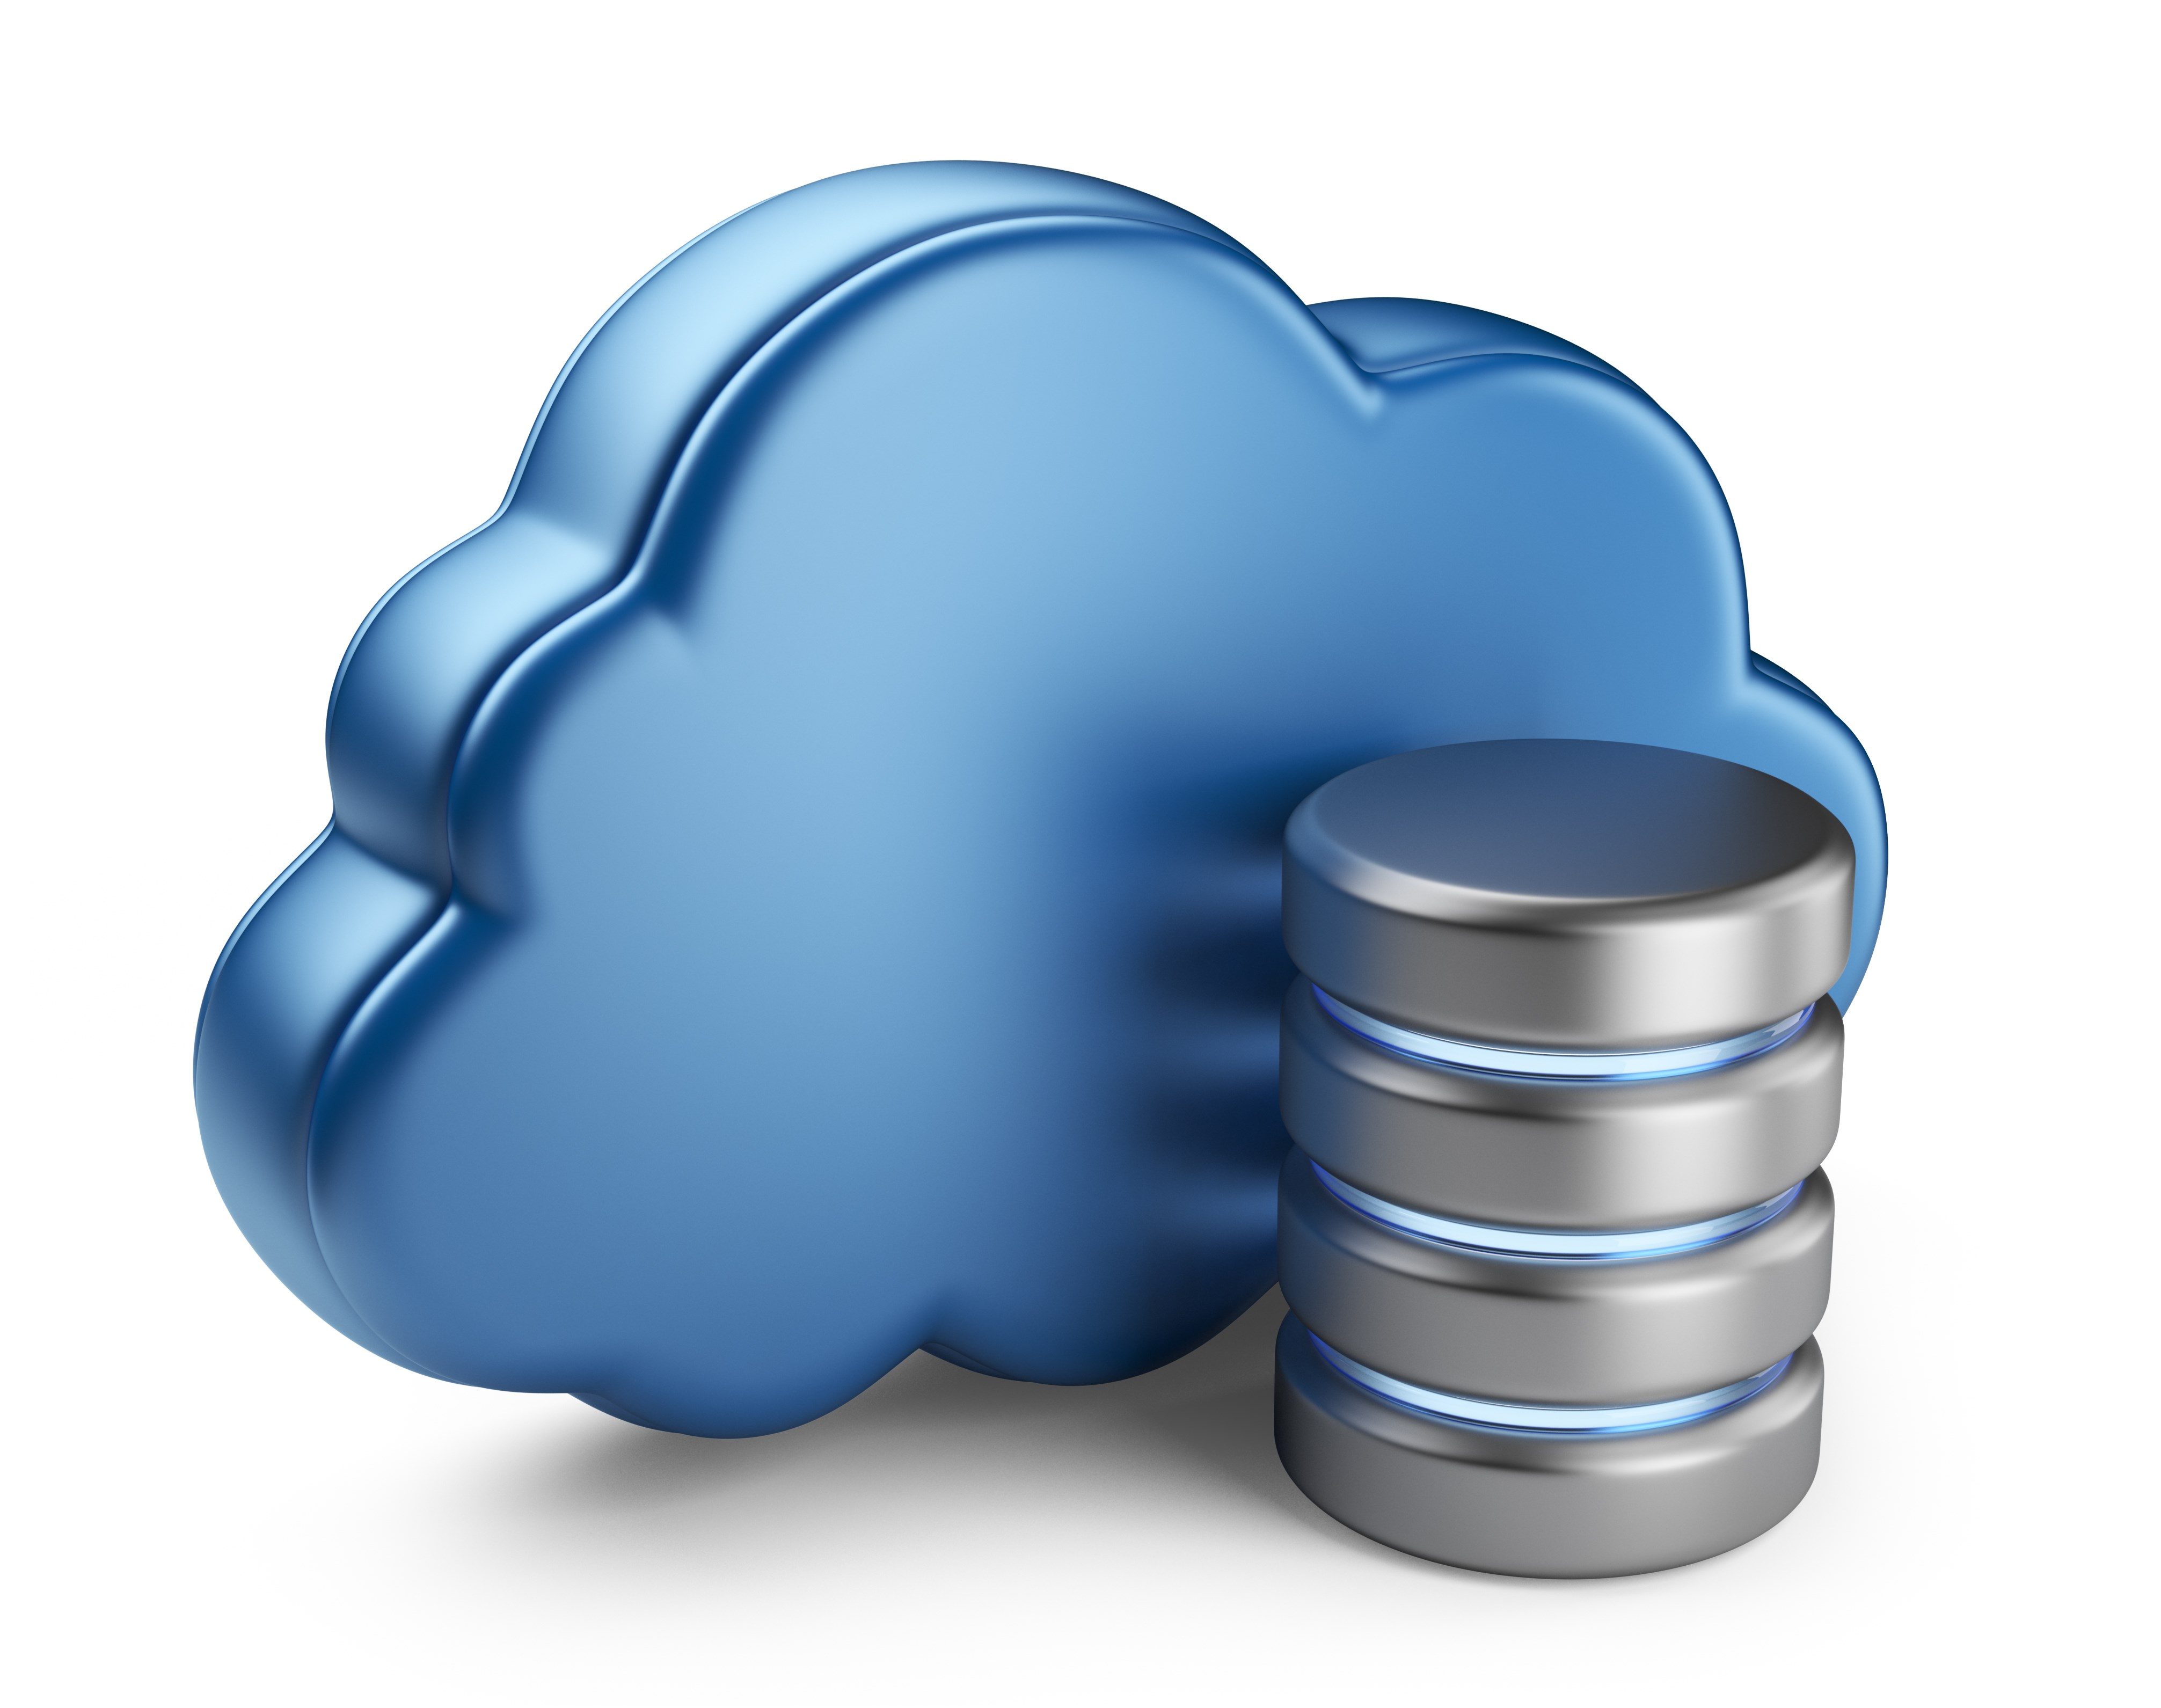
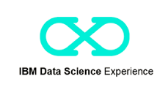






Sample Architecture
Source / Backend
Application development
Deployment
Scheduler
GitHub
Monitoring Dashboard
Maintenance / Updates
Notes:
Need explanation on this slide

